Slide 1
The State of .NET
And a bit about how we got here
Lunch & Learn – June 14, 2023
Matt Gallant

Slide 2
A bit of history: Why .NET?
Picture it… Early 1990s: Microsoft is looking for a more productive environment for developing Windows apps over C++ / MFC
Java is this new language and runtime from Sun that’s getting attention
Java looks promising but emphasizes platform agnostic / independent coding
Microsoft licenses Java from Sun and implements Microsoft Visual J++
  Idea to tailor things for the Windows environment; interop with Win32 important, for example.
The result is good, but it’s not compatible enough with “regular” Java such that Sun is gets very, very not happy and sues.
Ultimately, Microsoft loses the lawsuit and is blocked from continuing to ship J++

Slide 3
A bit of history: Why .NET? (2)
Microsoft decides that it will develop its own solution with a few key goals:
  Productive “safer” development
    Can we eliminate those annoying buffer overruns, help get rid of memory leaks, and the like… or at least spend less time dealing with them?
  Managed code – a suite of runtime services that applications would leverage for increased productivity
    Automatic memory management (GC)
    Common type system and Metadata
      Assemblies (the unit of deployment) are self-describing
    Common error handling (exceptions)
    Intermediate Language (IL) for architecture portability (like Java “bytecode”)
  Rich, reusable library
    No need to reinvent the wheel for new languages… invent a new language in the future, get the runtime library for free.
  Features like metadata and reflection that will be great for supporting tools

Slide 4
.NET Components
Common Language Runtime (CLR)
  Common Language Infrastructure (CLI)
  Goal of supporting MANY languages that can interoperate from the get-go
Base Class Library (BCL)
Language – C# a new language for .NET, but many others
  From Microsoft: VB.NET, F#, C++/CLI
  Previously: Iron Python, Iron Ruby … even J# (Java for .NET) for a bit
  Commercial offerings; for example, a .NET version of COBOL
SDK – Development time tooling
  MSBuild build system
  NuGet package manager (2010)

Slide 5
A Brief .NET Timeline
.NET first showcases as a beta in 2000
  Had been kept a pretty good secret by Microsoft and it generated a lot of interest
.NET Framework version 1.0 releases in early 2002
  Windows-only (integrated into Windows)
  ECMA standard for the CLI and C# would allow for non-MS, non-Windows implementations… if anyone bites
    “Rotor” reference source implementation published
“Mono” project is developed externally and releases (~2004) to support Windows, Mac and Linux.
  Gets picked up by Novell for a while
  Ultimately breaks away to become Xamarin; acquired by Microsoft in 2016

Slide 6
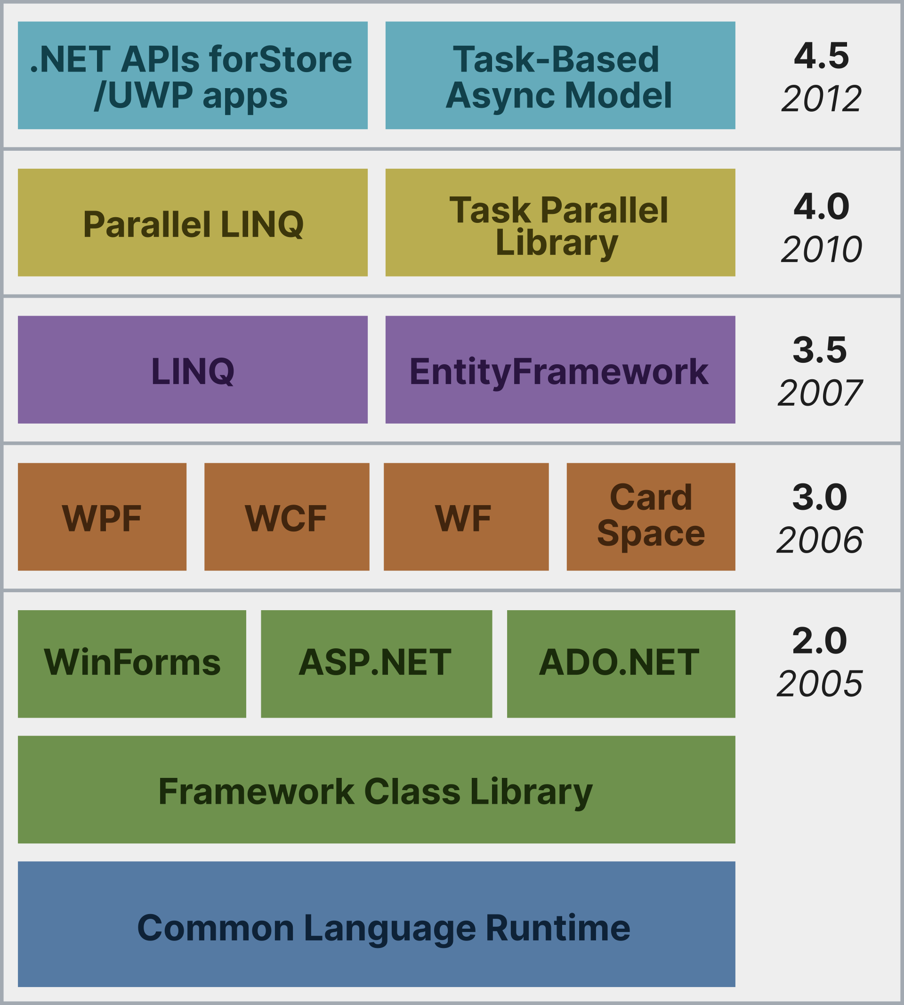
.NET Timeline (continued)
.NET Framework 4.8.1 is the latest version
No longer under active development
Supported and maintained (security hotfixes, etc.) for the life of Windows
Things start to get interesting and move into the “modern times” with C# 6
  Released with .NET 4.6 and supports first version of .NET Core
  This is also a rewritten version of the compilers (C# and VB.NET)… hold that thought
C# 5
C# 4
C# 3
C# 2
Source: https://upload.wikimedia.org/wikipedia/commons/thumb/5/5e/Dot-Net.svg/1920px-Dot-Net.svg.png

Slide 7
.NET Core
Leading up to C# 6 in mid-2015, everything seems to be web, web, web… cloud, cloud, cloud
Revamp of the platform to address this evolving landscape
  Cross-platform; officially support non-Windows (Mac and Linux)
  Modern deployment methodology (i.e. Not tied to OS as an OS component like it was on Windows with .NET Framework)
    More condusive to containerization
  Initial focus on web (ASP.NET Core), but doesn’t stay that way for long
  Huge continuing focus on performance.
    Today, achieves some of the highest TechEmpower benchmark scores which position it well against many other leading frameworks
  Open Source
  SDK: Cross platform tooling … and give the command line some love
    IDE integration is great… but should not be required.

Slide 8
.NET Core (2)
By .NET Core 3.0 (with C# 8 - Sept 2019), the new platform is “on par” with .NET Framework
  At least as much as it will be. Some technologies are deliberately not brought forward.
  Windows Forms and WPF now have .NET “Core” compatible versions
    Also now Open Source; these are the versions now being actively maintained and enhanced both by Microsoft and external contributors.
In .NET 5 (Nov 2020), there is a push to unify all the various flavors of .NET (especially now that Microsoft has acquired Xamarin)
  This is achieved with the BCL. There is only one codebase now.
    This is what makes .NET Standard moot going forward
  There are separate runtimes still, but that is largely implementation detail and there has been a lot of cross-pollination of technology bring them closer together.
  Note the “Core” moniker is dropped

Slide 9
What’s been going on lately?

Slide 10
.NET Compiler Platform (C# 6 / VB 11)
Codename “Roslyn”
The compilers were rewritten in their own languages (previously they were C++)
Written to modern design practices… we write code very differently than in ~2000
  Lots of code in a more functional style: immutable / “persistent” data structures, more ability to be “lock-free”
Written such that the compiler and its components are exposed as an API…
  Unlike a lot of compilers which are mostly black boxes
  “The One” true compiler
    “Nobody should have to write a C# / VB parser again”
  Language Services - to power tooling such as IntelliSense… can also leverage the compiler as an API rather than being something that had to be maintained in parallel before
  Extensibility

Slide 11
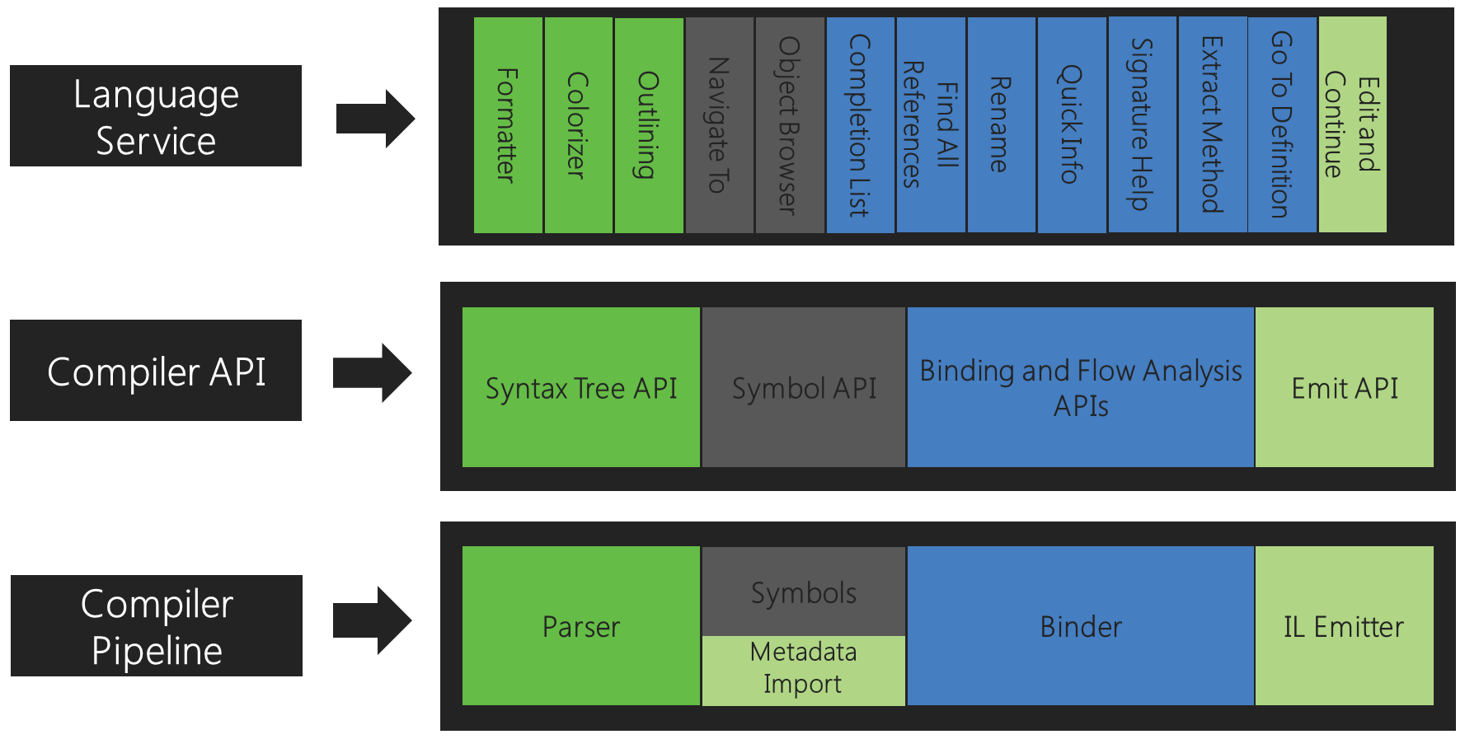
.NET Compiler Platform
Source: .NET Compiler Platform SDK concepts and object model

Slide 12
“Roslyn” Extensibility - Analyzers
The .NET Compiler Platform designed for extensibility with the ability to plug in…
  Analyzers (and code fixers)
    Analyzers register themselves to be invoked by the compiler at certain phases, examine the compilation, and emit additional diagnostics (errors, warnings, suggestions)
    Optionally, implement “fixers” the developer can invoke to change code to comply with a suggestion, for example. Surfaced in the Visual Studio “light bulb” tool
    Some are in box in the SDK, can be packaged as NuGet packages and added to projects. Third-party libraries can include them as companions to help guide you in the library’s usage.
      i.e. NUnit does this

Slide 13
“Roslyn” Extensibility – Code Generators
Code Generators (starting in C# 9)
  The ability to again extend the compiler this time to generate code that augments the developer’s code
  Over time, Microsoft is making various generators available in the SDK
  Can be made available by third parties via NuGet
Examples – help reduce the burden of writing tedious code
    .NET 6: Logging source generator (Compile-time logging source generation - .NET)
    .NET Community Toolkit (via NuGet)
      Includes MVVM-related code generator for supporting INotifyPropertyChanged and friends.
This is cool stuff… but it’s not just for coolness factor…

Slide 14
Native AOT (Ahead of Time Compilation)
Wouldn’t it be nice if we didn’t have to JIT the code from IL to native when we run it?
  This is not a new idea in .NET
    .NET Framework had “NGEN” – an optional install-time optimization
      This is where the *.ni.dll binaries come from in the GAC, for example.
    In Mono, native code generation was necessary for iOS support (Xamarin)
      iOS doesn’t permit any sort of dynamic code generation so the final deployment bundle had to contain everything the app could need in a compiled-to-native form
    .NET Core era brought “ReadyToRun” and Tiered compilation, which is still an option
    UWP (“Windows Store”) apps that are implemented in .NET are all pre-compiled (no-JIT) but at this time use a separate .NET CLR
But the new hotness is more broad support for “Native AOT”:
  Ability to publish an application compiled beyond IL (Intermediate Language) to the target native CPU code at build time
  The code is still “managed”; there is still a CLR (GC, type system, “safe” code by default) but it just lacks a JIT compiler
  Everything ultimately can also be combined into a single binary
  All the “unused” code trimmed away
For applications that can use it, it can bring great performance improvements particularly during start-up which is normally JIT-heavy.
Compiling ahead of time (during build) also gives the opportunity for better code-gen (optimizations)
But you give up things…
  As there is no JIT in the runtime… this can’t be used if anything in your application (including your third-party dependencies) relies on dynamically generating code at runtime.

Slide 15
Code Generators – replacing the need for dynamic code
Further examples of “in the box” source generators Microsoft
  While these can be used simply for the perf benefits of not relying on dynamic code generation (which can be slow and rely on runtime reflection), if you’re looking to “native AOT” they become necessary
Examples
  (.NET 6) JSON Serialization with System.Text.Json (How to use source generation in System.Text.Json)
  (.NET 7) RegEx (.NET regular expression source generators)
  (.NET 7) Library Import (P/Invoke source generation)
    A code-gen way of doing P/Invoke vs. relying on CLR “magic”
    Coming: The same thing for COM Interop on Windows which is something the CLR traditionally has “magically” handled itself. Native binding generation on other platforms.

